Slide 1


European Cities Recommender
A final Project by Luis
Data Analytics - Ironhack

Slide 2

Index
Introduction
Data
Model
Application
Future Improvements

Slide 3
European cities recommender
Which city suits the best for me within Europe?
User select what is important and get recommendations. Which city fits better with the given preferences.
Main idea is to search where to live but could be use for touristic purposes with new developments.

Slide 4







Data
Eurostat (https://ec.europa.eu/eurostat/web/cities/data/database)
29 Countries
850 Cities
Living
conditions
Labour
market
Education
Transport
Environment
Demographics

Slide 5



Model
Data Preparation
Irrelevant data removal
Deduplicate data
Fix metadata

Slide 6

Model
Data Preparation
Irrelevant data removal
Deduplicate data
Fix metadata

Slide 7

Model
Data Preparation
Irrelevant data removal
Deduplicate data
Fix metadata
NULLS
NaN
NaN
NaN
NaN
NaN

Slide 8
Feature Selection
Model is unsupervised Machine Learning – clustering
The user needs to input values for the variables.
Reduce the user inputs.
With these conditions:
Manual Feature Selection
Features with few nulls
Features that are indexes better than absolute values

Slide 9
Model
Model is unsupervised Machine Learning – clustering
Data Preprocessing. Scale the data
Select the best model: Kmeans, DBScan, fuzzy c-means.....

Slide 10
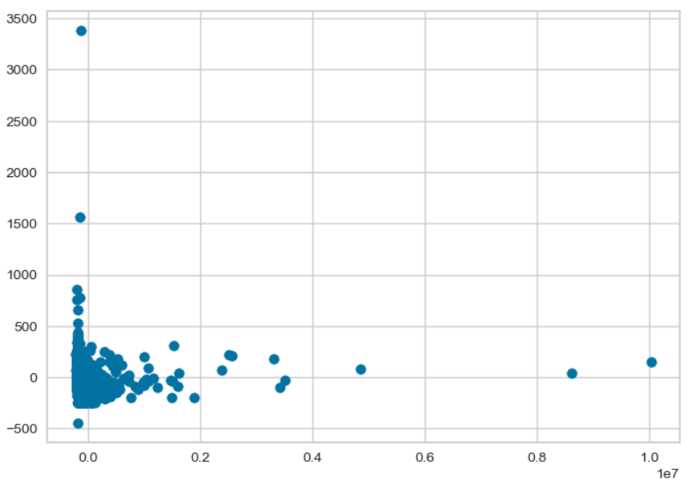
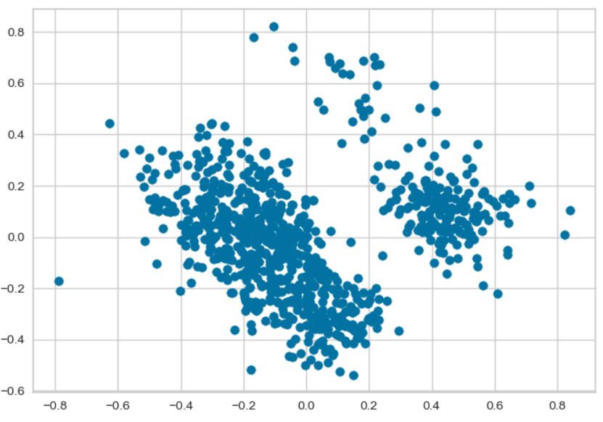
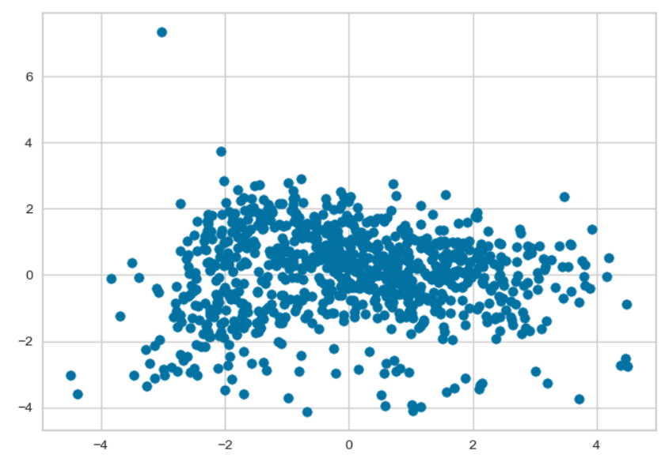
Model
 | No Preprocessing | Min Max Scaler | Standard Scaler
Raw FCA

Slide 11
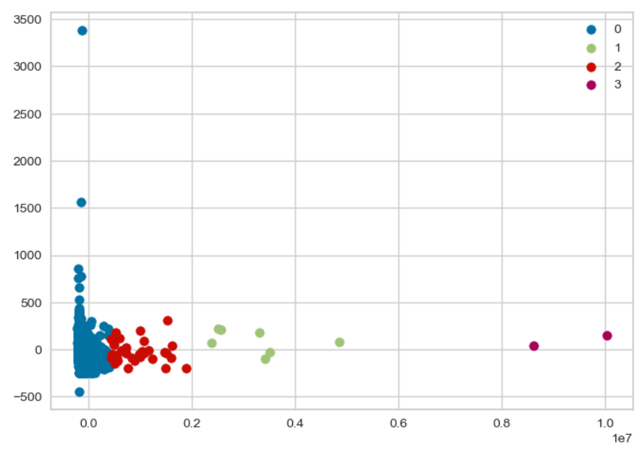
Model
 | No Preprocessing | Min Max Scaler | Standard Scaler
Raw FCA
K Means
DBSCAN
Fuzzy c-means

Slide 12
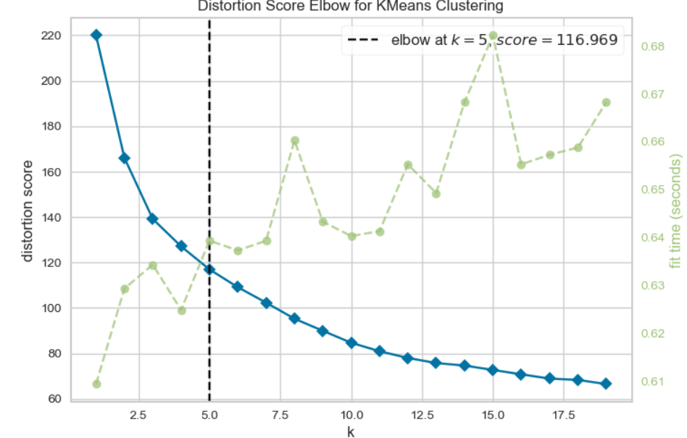
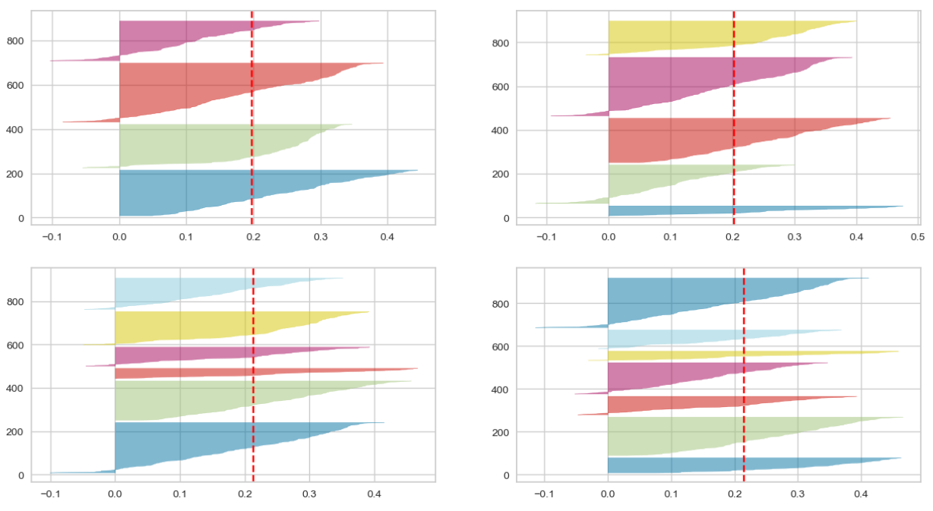
Model
 | No Preprocessing | Min Max Scaler | Standard Scaler
Raw FCA
K Means
DBSCAN
Fuzzy c-means

Slide 13
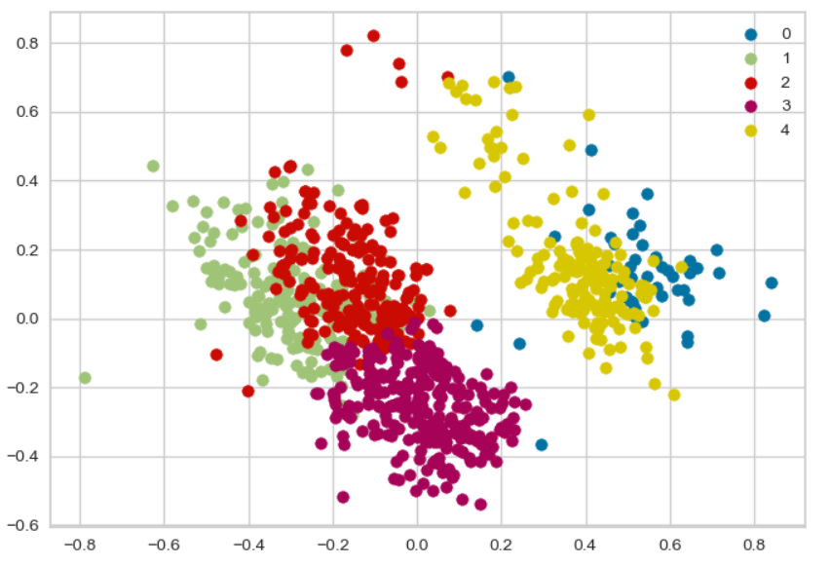
Model
 | No Preprocessing | Min Max Scaler | Standard Scaler
Raw FCA
K Means
DBSCAN
Fuzzy c-means

Slide 14
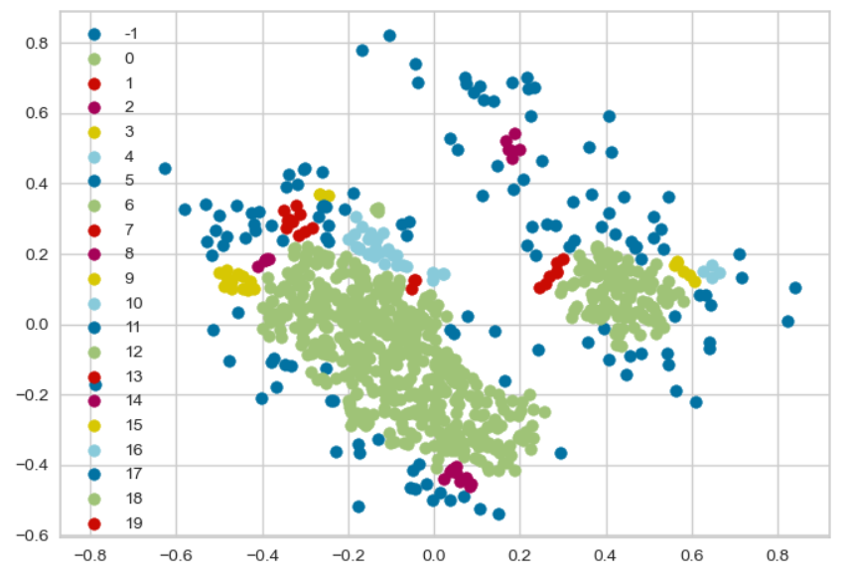
Model
 | No Preprocessing | Min Max Scaler | Standard Scaler
Raw FCA
K Means
DBSCAN
Fuzzy c-means

Slide 15
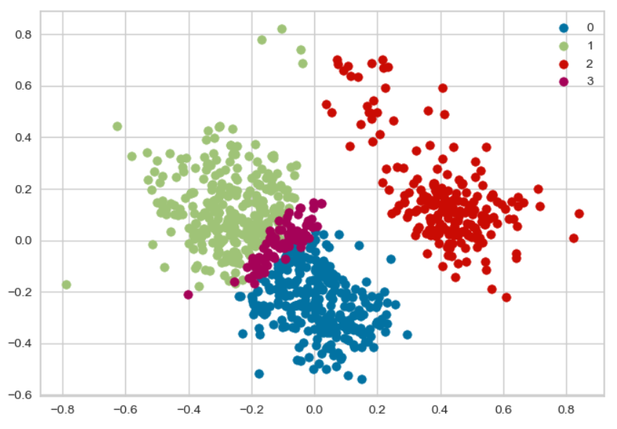
Model
 | No Preprocessing | Min Max Scaler | Standard Scaler
Raw FCA
K Means
DBSCAN
Fuzzy c-means

Slide 16
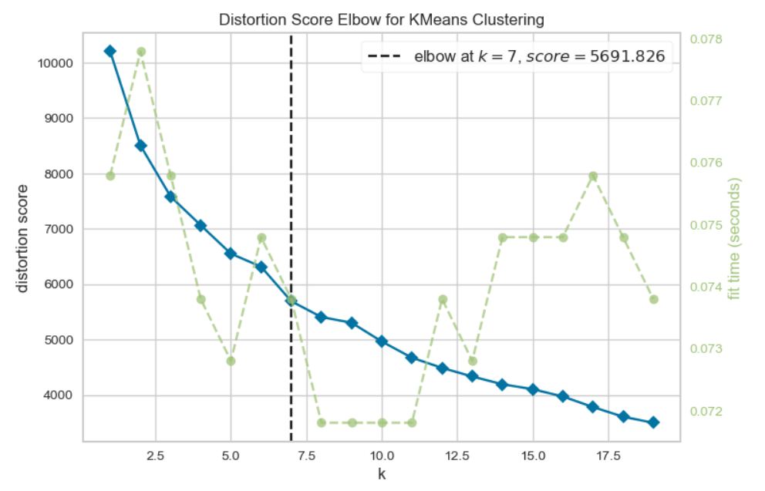
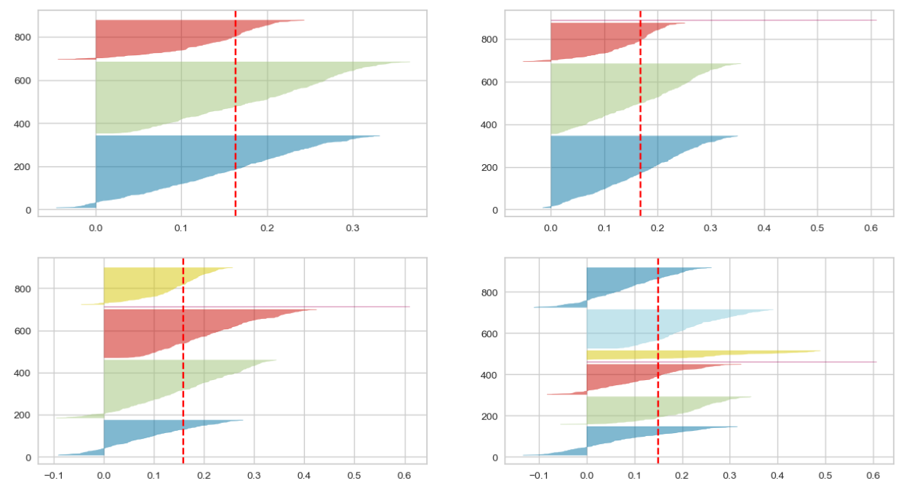
Model
 | No Preprocessing | Min Max Scaler | Standard Scaler
Raw FCA
K Means
DBSCAN
Fuzzy c-means

Slide 17
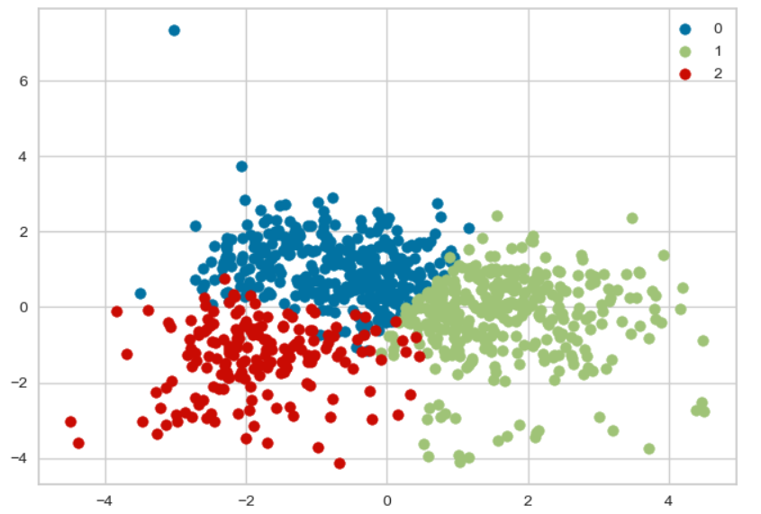
Model
 | No Preprocessing | Min Max Scaler | Standard Scaler
Raw FCA
K Means
DBSCAN
Fuzzy c-means

Slide 18
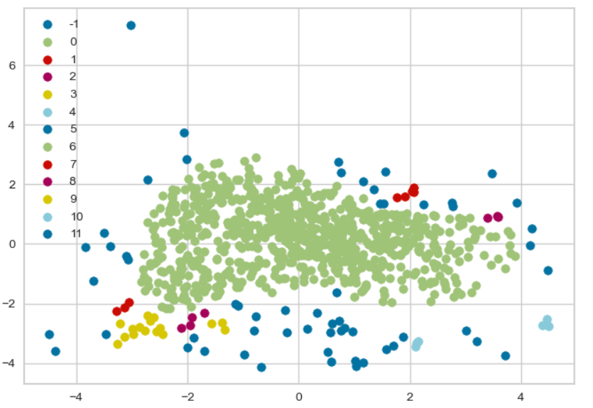
Model
 | No Preprocessing | Min Max Scaler | Standard Scaler
Raw FCA
K Means
DBSCAN
Fuzzy c-means

Slide 19
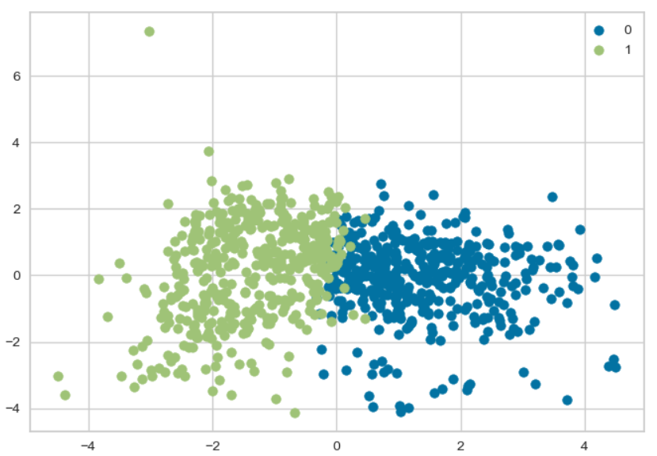
Model
 | No Preprocessing | Min Max Scaler | Standard Scaler
Raw FCA
K Means
DBSCAN
Fuzzy c-means

Slide 20
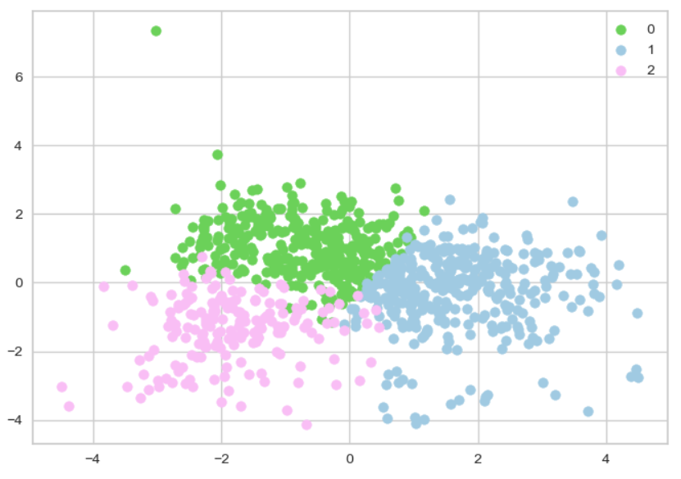

Model
Kmeans
K=3
Tranformation: Standard scaler
Model: Kmeans

Slide 21
Application - Streamlit

Slide 22
Improvements
Feature Engineering. Summarize 200 variables in 8 features.
Create a model for each topic (Regression or Classification)
Clustering with more features but user input max. 8 value
Webscrapping variables like hours of sunlight, temperatures
Create a selection with different model for male/female
Include LGBT data

Slide 23
Thank you Gracias Merci Dankeschön Terima kasih Cảm ơn धन्यवाद
Благодаря ти много Спасибо 非常感谢
Gràcies Bedankt ευχαριστώ

